Slide 1

Success with Kofax & AI The problem with Accuracy
Workshop
David.Wright@Kofax.com
Partner Development Manager
Notes:
Winning the Customer in the Cognitive/AI/RPA World.
Session Goals :Understand and articulate the value of focusing on human performance rather than machine performance in RPA & CDA opportunities.
Various Case Studies to make the problem very clear.

Slide 2

We need Automation!
We need Accuracy!
Notes:
What does “Automation” even mean?
What is a “robot”? Isn’t a “robot” an “automation”? No, it’s an “automaton”.

Slide 3
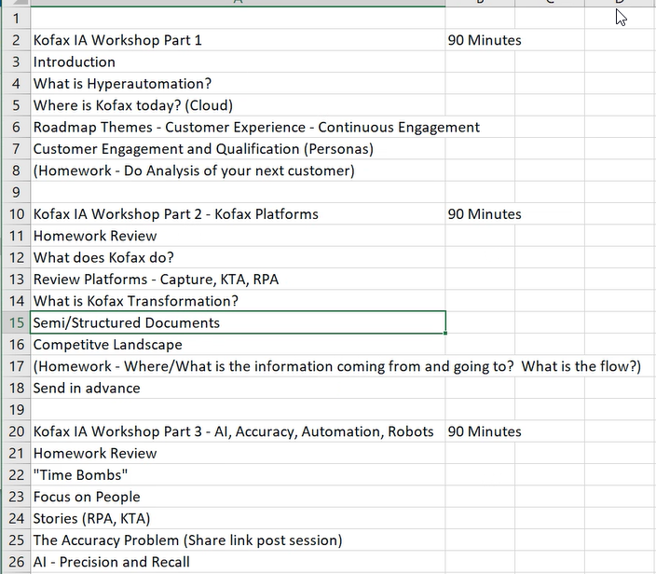

Slide 4

A Process
30
35
40
25
130
Notes:
Each person can process 25 boxes by themselves. So 4 people can process 100 boxes together. This is a process

Slide 5
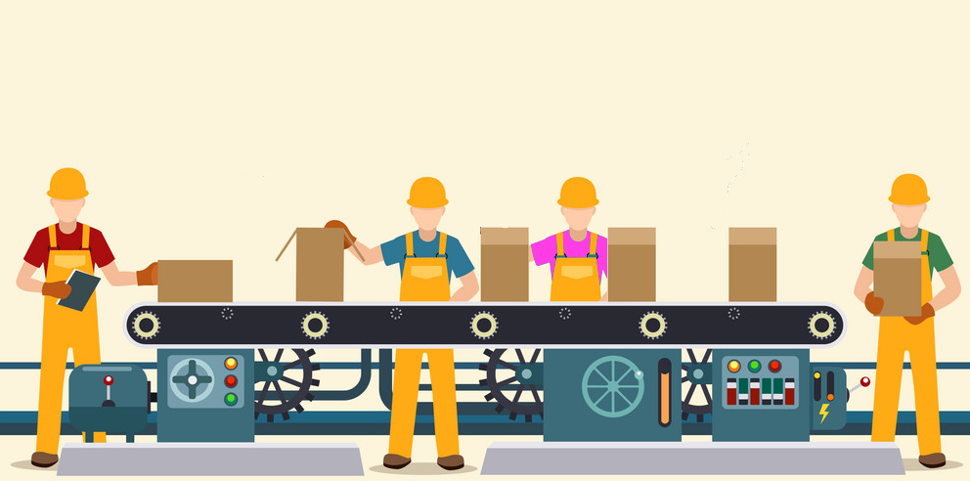
Process Automation
190
200
210
220
190
Notes:
When you separate tasks so that each person does something different, the 4 people can process 200 boxes together. This is process automation.

Slide 6
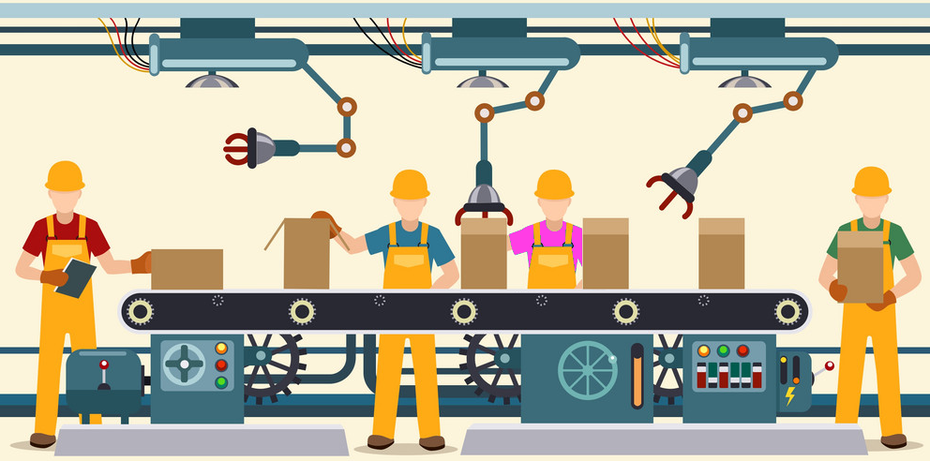
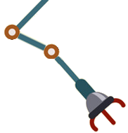



Robotic Process Automation
360
400
320
300
380
320
390
290
305
360
400
4000
400
Notes:
Add 3 robots. 4 people can now process 300 boxes. This is robotic process automation. The humans are assisted by robots.
It doesn’t make sense to say that 3 robots process 100 boxes. It doesn’t actually matter what the robots do. It makes sense that the people process 400 boxes with the help of robots.
If robot#2 can shut 200 boxes does that actually mean anything?
The value of the 3 robots is +100 boxes or +33%. By measuring the humans we know the PRECISE VALUE of the robots, and can calculate accurately the ROI of the robots.
But it gets better. We can ask the question “How do we get better than 300 boxes?”
Now we are open to many choices. We can score them all on human improvement and then implement the solution that gives the most value.
Add another robot
Make blue and purple person swap place.
Give green a table.
Red should stop using a clipboard.

Slide 7
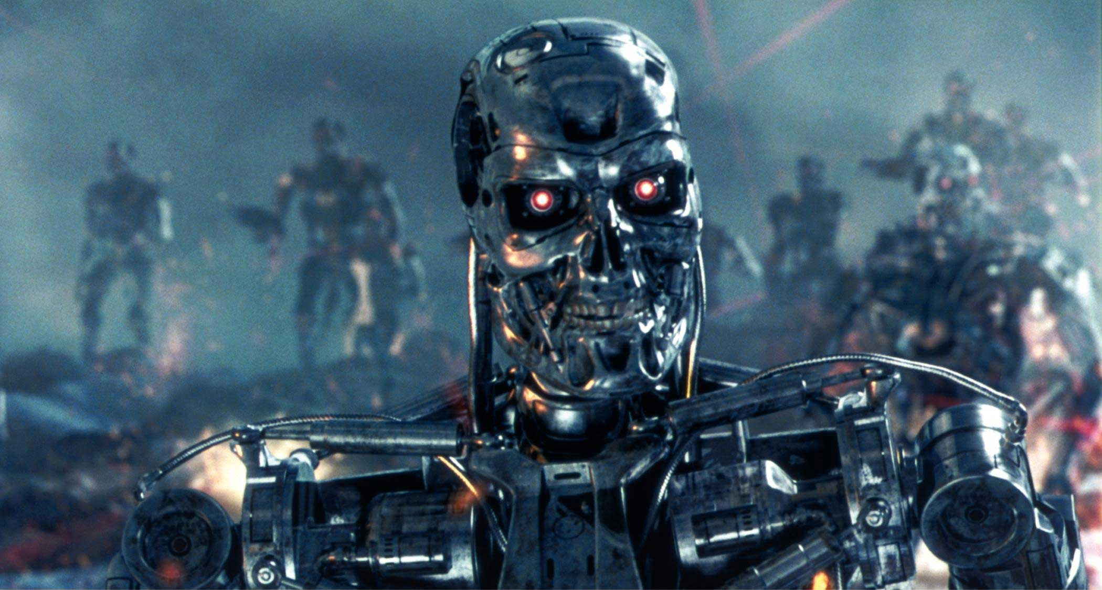
Notes:
Is your understanding of RPA stuck in the 1980’s with robots coming to take your job?
The Terminator movies of 1984 and 1991 personified the risk of AI as terminator robots intent on killing humans, so the humans rebelled. The “AI Skynet” they were talking about then was actually just a database: the SQL database was entering into the business world – data was being digitized. No-one fears a database today more than 30 years later. The AI fears of today will not concern our children.

Slide 8
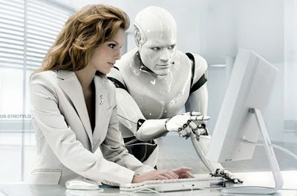

Notes:
Great KT solutions build wonderful collaboration between humans and robots. Robots always support humans, never replace them. This picture describes in great detail what we are doing with Kofax Transformation – always putting the human in the center and in control, with human hands on the keyboard. The human never gives control to the robot and the human remains always responsible. We do not let AI make decisions about human lives – only humans can do that.

Slide 9
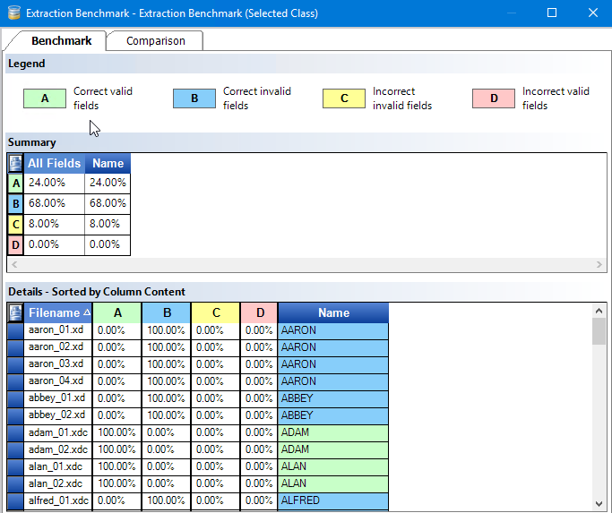
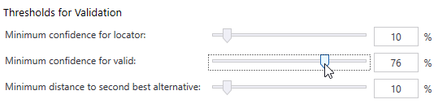
Threshold Optimizer
What is
the best threshold??

Slide 10


The OCR problem

Slide 11
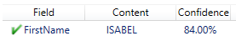
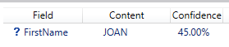

How our customers see OCR
✓
We need
85% accuracy!
≥ threshold valid
Confidence threshold
< threshold invalid

Slide 12






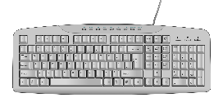


Some real examples
Accuracy
☠
✓
correct and valid
incorrect and valid
Correct and valid
correct and invalid
incorrect and invalid

Slide 13


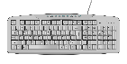
A real example
447 handwritten names using Parascript FormXtra 7.6 OCR profile “Hand Alphabetic”
✓
☠
Confidence threshold | correct & valid | correct & invalid | incorrect & invalid | incorrect & valid
80% | 18.3% | 72.5% | 8.9% | 0.2%
 | Accuracy = 90.8%
 |  | Human effort = 81.4%
 | - | 1 second | 1.5 seconds | -
 |  | =0.86 seconds
 |  | Productivity gain = 1.74
= 1 x .725 + 1.5 x 0.089
= 1.5 / 0.86
Notes:
Human+Kofax = 0.86
Human alone = 1.5
Kofax produces a 1.5 times boost/productivity gain

Slide 14


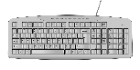
Optimization Process
☠
:
$€¥£
✓
OCR Configuration | Optimum Confidence | Correct &Valid | Correct &Invalid | Incorrect &Invalid | Incorrect &Valid | Accuracy | Human required | Correction ratio | Productivity gain
Alphanumeric | 82% | 0.2% | 83% | 16.8% | 0.0% | 83.2% | 99.8% | 17% | 1.4
Alphabetic | 80% | 18.3% | 72.5% | 8.9% | 0.2% | 90.8% | 81.4% | 11% | 1.7
FirstName | 79% | 15.2% | 72.3% | 12.5% | 0.0% | 87.5% | 84.8% | 15% | 1.6
Alpha + 2300 Names | 67% | 51.9% | 37.4% | 10.7% | 0.0% | 89.3% | 48.1% | 22% | 2.8
= 89.3%
=
Kofax focuses on humans and human problems, not on software and robot metrics – we find the optimal solution that reduces human effort and saves money.

Slide 15

Change the conversation with your customers
$€¥£
Accuracy and Confidence
Productivity Gain
Notes:
http://1.bp.blogspot.com/_6SchU8D-e1s/TQjtsuh0-tI/AAAAAAAAn4Y/0FHaAX_WEh4/s400/human-vs-robot-13.jpg

Slide 16
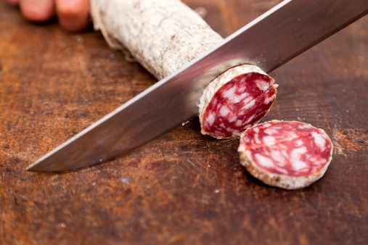
Salami

Slide 17
What’s happening with Artificial Intelligence?

Slide 18
Buzzwords
Intelligent
Smart
Clever
Cognitive

Slide 19
Not Buzzwords
Machine Learning
Deep Learning
Learn-by-example
Supervised machine learning
Bayesian classifiers
Natural Language Processing

Slide 20

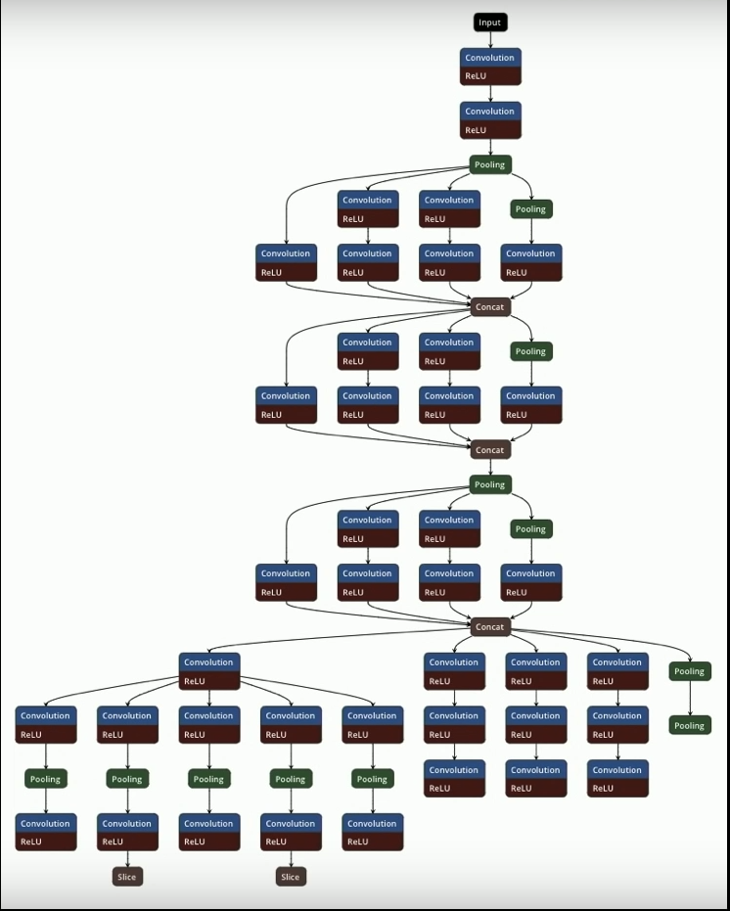
AI can be very complicated
Notes:
Tesla’s Self Driving Car AI is a network of Deep Learning Networks.
Good AIs need incredibly skilful AI Engineers.
Tesla Autonomy Day
Streamed live on Apr 23, 2019
https://youtu.be/Ucp0TTmvqOE?t=5110

Slide 21
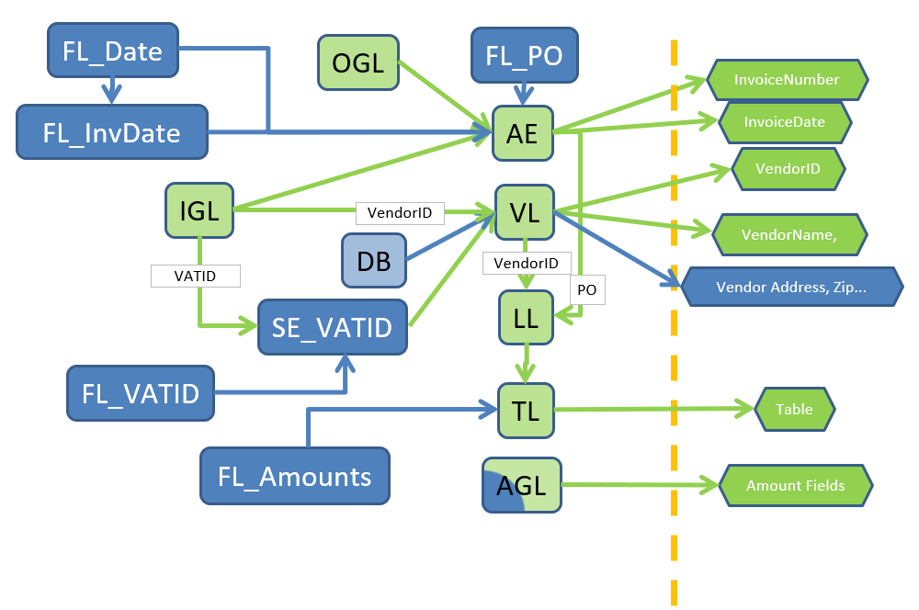
Invoice processing: AI + rules + rescoring + lookups + flow + learning
Trainable
Rules-based
Pattern-based classification
Fuzzy index lookup
5 Table detection algorithms
Text pattern recognition using SQL results
Rescoring algorithms

Slide 22
Problems that Kofax tackles with AI
Reasoning and Problem Solving
Natural Language Processing
Creativity
Knowledge Represen-tation
Motion
and Manipu-lation
Planning
Perception
Learning and Adaptation
Social Intelligence
Notes:
Perception:
Computer Vision
Pattern matching
Sensors, cameras, mics
Face recognition
What is in the image? (ImageNet competition)
NLP:
Speech
ICR/OCR
Translation
Intent, Sentiment, Entities
Chatbots
Learning and adaption:
Generalization, unknown situations
Classification
Machine Learning
Planning:
Go find the bananas in the other room
Intelligent Agents / Multi Agent Systems
Provisioning, Logistics

Slide 23
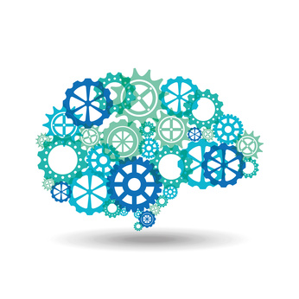
Document Classification*
Data Extraction*
Language Detection*
Table Header Detection*
Paragraph Separation
Predictive / Probabilistic
Document Separation*°
Image Cleanup
Document Clustering
RPA Process Analysis
Machine Learning
OCR | ICR
Mobile OCR
VRS page rotation
Neural Network
Artificial Intelligence at Kofax
Signature Verification
Facial Recognition
Handwriting Detection
Natural Language Processing
Context Extraction*
Sentiment Analysis
Named Entity Recognition
Syntax
Analysis
Document Summarization
= Roadmap item
Vision
Image Classification*
Line detection
RPA Dynamic Screen Interpretation
Document Edge Detection
= Supervised ML
= Unsupervised ML
*
= trainable
°
= Hidden Markov Model
= Kofax Transformation

Slide 24

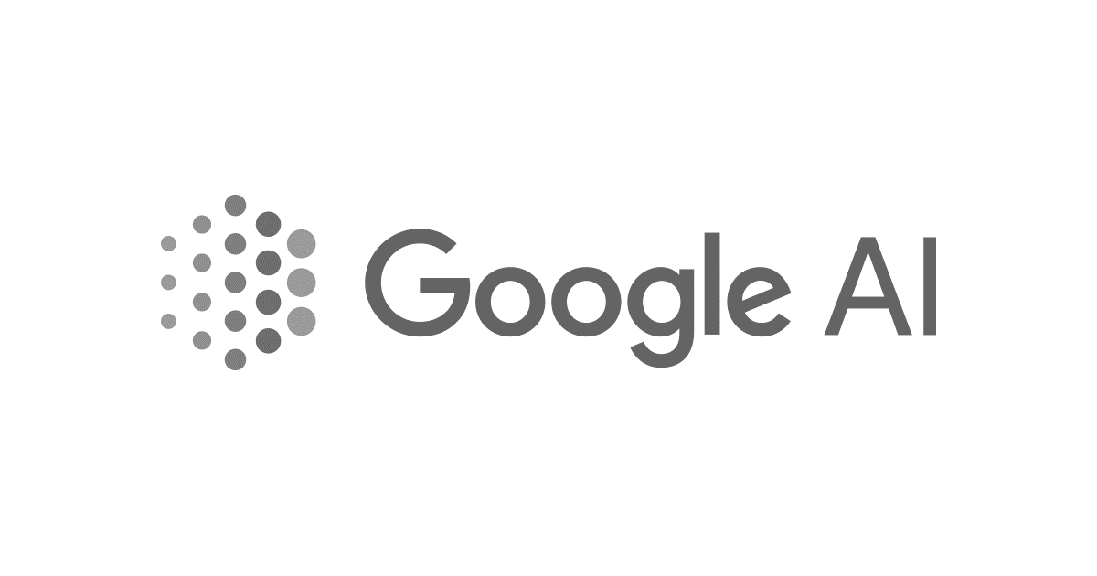






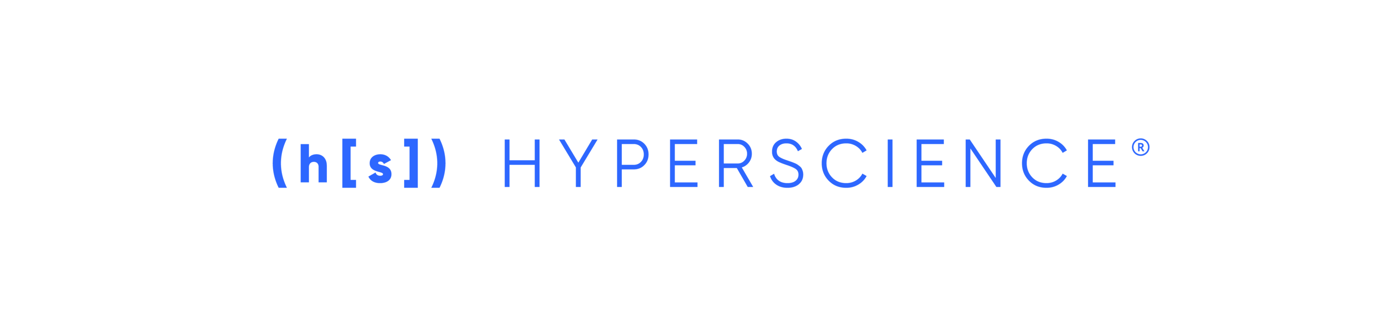


Kofax-orchestrated AI.
Connecting to specialized algorithms, to create solutions out of services.
Providers listed are examples only

Slide 25
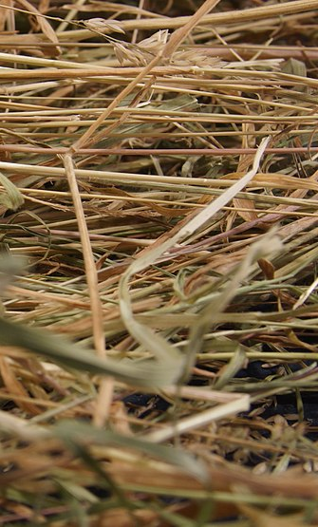
AI is often looking for the Needle in the Haystack
5 Needles and 10 Hay – Precision & Recall
In the perfect world:
We find 5 needles and 0 hay.
Precision=100%
Recall = 100%
If we find 4 needles and 3 straw:
Precision = 4 from 7 are needles = 57%
Recall = 4 from 5 needles found = 80%

Slide 26


True/False Positive/Negatives
Most AI companies are misleading when they give accuracy metrics, because they give you TP+FN, and they NEVER tell you what is happening with the false positives.
Do not believe or trust them, ask them for False Positive and False Negative rates.
Even Precision/Recall metrics obscure the truth.
FP
TP
FN
TN

Slide 27
4 problems that AI is used to solve
Recall
Find all the angry customers to make them happy.
Precision
Try to deal with angry customers quicker
Trend
Are our customers angrier than yesterday?
Transaction
What does customer X want? (False Positives are DEATH)

Slide 28

The Future of the Digital Workforce
Head Work: Cognitive Automation
Hand Work: RPA
Notes:
[Talk track: RPA addresses the low-hanging fruit—a cost-effective way to transform cubicle work today. You also want to look towards the future as you plan and map out your digital strategy and prepare your organization to operate as an optimally-performing intelligent enterprise. For example, much of the Know Your Customer compliance process is very labor-intensive, mundane work being done by highly-skilled analysts. RPA automates that mundane, manual work. AI analyzes it.]

Slide 29
Document Understanding
Cognitive Document Automation
Intelligent Document Recognition
Human & robot together understand what they read

Slide 30



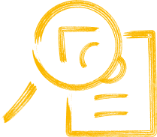

What is Document Understanding? (All information has context)
General Knowledge
Specific Knowledge
Learning
Understanding
=
Reading
+
+
+
Precisely knowing the intent of the author
OCR
Letters & words
This is not understanding
People’s names, City names, Tax rates, Mathematics, Month names, Job names…
Date of birth of each customer, order database signature always on the last page.
Remember and use new general & specific knowledge next time.
Notes:
Reading= OCR = intelligence of a 4 year old child.
General knowledge (about documents and the world)= city names, zips codes, mathematics, languages, spelling, month names, common occupations.
The words “date” and “Datum” often appear to the left of a date.
One Third of Americans share only 1000 family names – Smith, Johnson, Williams, Brown, Jones, Miller, Davis, Garcia, Rodriguez.
Robots are good at getting general knowledge about the world.
Specific knowledge (about this document) = the address and date of birth of every customer. Database of recent orders. This document always has the date in top left corner.
Learning by observing= gaining general and specific knowledge.

Slide 31
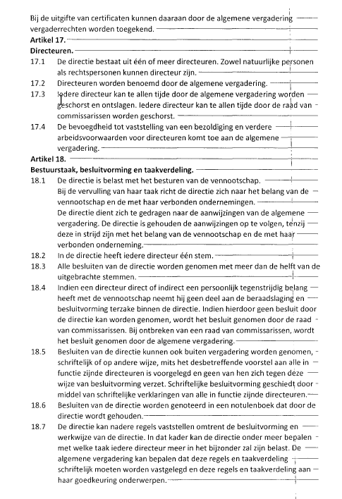
Document Understanding –what does the document mean?
Document
Data
Class | Corporate contract
CustomerID | 65483
Document Date | 23/11/2018
Signed | True
Stock owned | 25%
Expiry | 31/12/2027

